Slide 1
Employee Data Analysis using Excel
STUDENT NAME:G.priya
REGISTER NO:312217030(93DAFB77A822B85930E438C5AEEA3AA8)
DEPARTMENT:B.com(general)-B
COLLEGE: Shri Krishna Swamy college for women

Slide 2
PROJECT TITLE
CREATING AN EMPLOYEE PERFORMANCE SCORECARD IN EXCEL

Slide 3


AGENDA
Problem Statement
Project Overview
End Users
Our Solution and Proposition
Dataset Description
Modelling Approach
Results and Discussion
Conclusion
3/21/2024 Annual Review

Slide 4
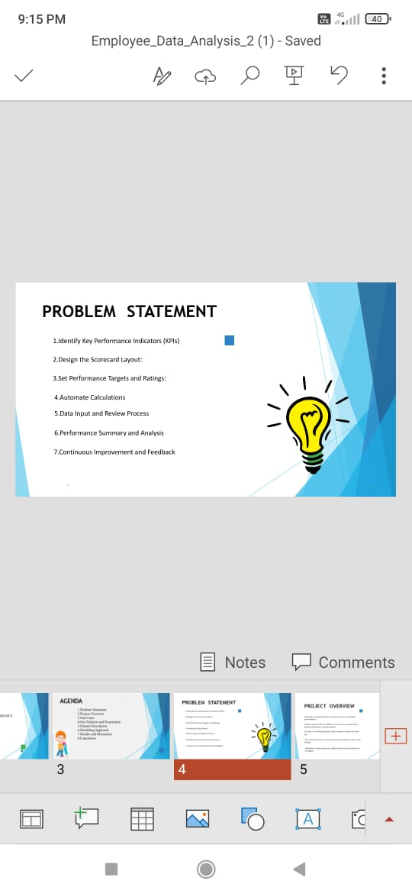

PROBLEM STATEMENT
Problem Description
Problem Description
Problem Description
Problem Description
Context
Problem Description
Context
Impact
Objective
Scope

Slide 5

PROJECT OVERVIEW
.
1.Project objective
2.Key deliverables
3.Scope
4.Timeline
5.Budget

Slide 6

WHO ARE THE END USERS?
1.Managers/Supervisors
2.Employee
3.Executive
4.Human Resources (HR)

Slide 7

OUR SOLUTION AND ITS VALUE PROPOSITION
1.Customizable Performance Metrics
2.Clear and Structured Layout
3.Data Visualization:
4.Automated Calculations:
5.Performance Tracking:

Slide 8
Dataset Description
1.Employee Information
2.Performance Metrics
3.Evaluation Period:
4.Comments/Feedback
5.Action Plan

Slide 9

THE "WOW" IN OUR SOLUTION
1.Define the Metrics
2.Set Up the Excel Sheet
3.Calculate Scores
4.Visualize Data
5.Add Summary and Comments
3/21/2024 Annual Review
9

Slide 10
MODELLING
1.Define Performance Metrics
2.Set Up the Scorecard Template
3.Input and Calculate Scores
4.Add Conditional Formatting and Visuals
5.Include Comments and Summary
10

Slide 11
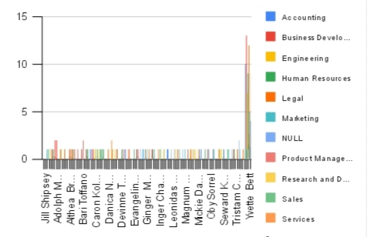
RESULTS
11

Slide 12
conclusion
1.Review the Scorecard Design
2.Validate the Data
3.Use Conditional Formatting
4.Incorporate Visuals
5.Collect Feedback
6.Document and Train

